Slide 1
Approximation-aware Partitioning for Periodic Tasks on an Approximate-Exact MPSoC by: Stefan Huemer
A review on the RISC-V core used in the project:
Modules that connect to each other using the AXI-Light interface.
Using these modules, bigger components can easily be constructed, for example a Node, consisting of a CPU module among others.

Slide 2
PicoRV32 structure and modules:
module picorv32
module picorv32_regs
module picorv32_pcpi_mul
module picorv32_pcpi_fast_mul
module picorv32_pcpi_div
module picorv32_axi
module picorv32_axi_adapter
module picorv32_wb
RV32 I/M/C core
Can be defined by paramteres in Verilog code
Register File
Co-Processor modules
AXI4_lite interface
Memory and I/O interface
Wishbone interface

Slide 3
PiXoRV32 structure and modules:
module picorv32
module picorv32_regs
module picorv32_pcpi_mul
module picorv32_pcpi_fast_mul
module picorv32_pcpi_div
module picorv32_axi
module picorv32_axi_adapter
module picorv32_wb
RV32 I/M/C core
Can be defined by paramteres in Verilog code
Register File
Approximate Multiplier as a Co-Processor
AXI4_lite interface
Memory and I/O interface
Wishbone interface

Slide 4
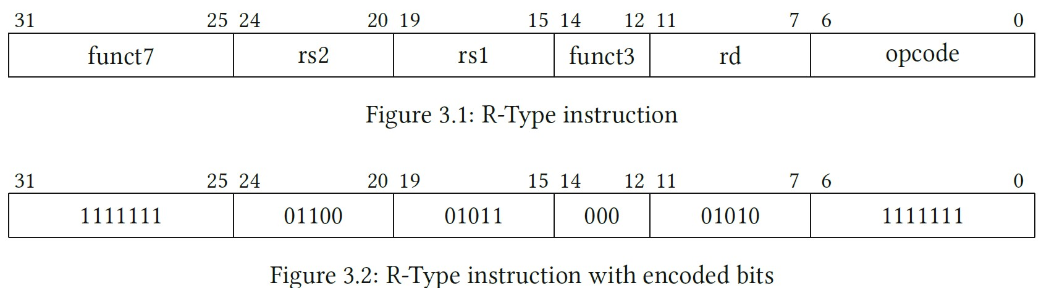
New R-Type instruction defined in RISC-V ISA:
Hard coded word with the value 0xF EC5857F
R-Type instruction with an opcode not used by original ISA
C code for approximate multiplication function:
__attribute__((noinline))
int amul( int rd , int rs1, int rs2)
{
asm__volatile__(".word␣0xFEC5857F\n");
asm__volatile__("addi␣%0,␣x10,␣0":"=r"(r));
return rd;
}
R-Type instruction
R-Type instruction with encoded bits

Slide 5
New R-Type instruction defined in RISC-V ISA:
Hard coded word with the value 0xF EC5857F
R-Type instruction with an opcode not used by original ISA
C code for approximate multiplication function:
__attribute__((noinline))
int amul( int rd , int rs1, int rs2)
{
asm__volatile__(".word␣0xFEC5857F\n");
asm__volatile__("addi␣%0,␣x10,␣0":"=r"(r));
return rd;
}
R-Type instruction
R-Type instruction with encoded bits

Slide 6
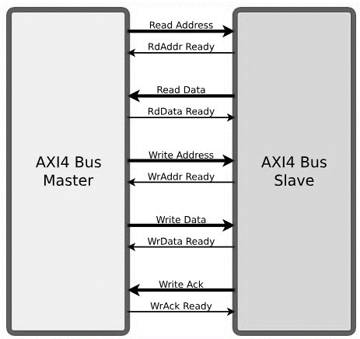
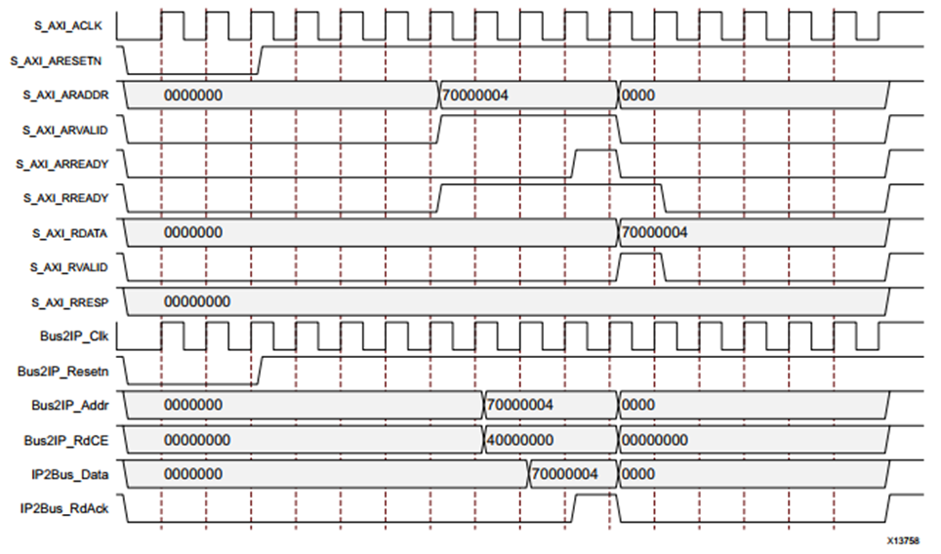
NoC and PicoRV32 connection: AXI4-Lite

Slide 7
Implementation and Simulations:
Software: C++ application GNU / Verilator
Synthetize tool: Xilinx Vivado (FPGA)
Memory Packer: BRAM on FPGA

